Slide 1
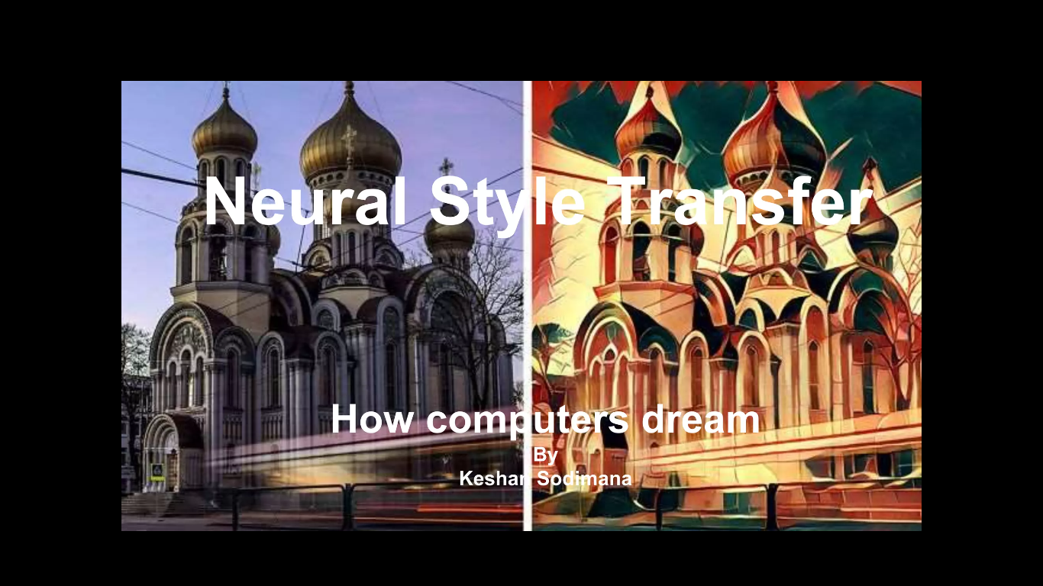
Monu Kumar Soyal

Slide 2
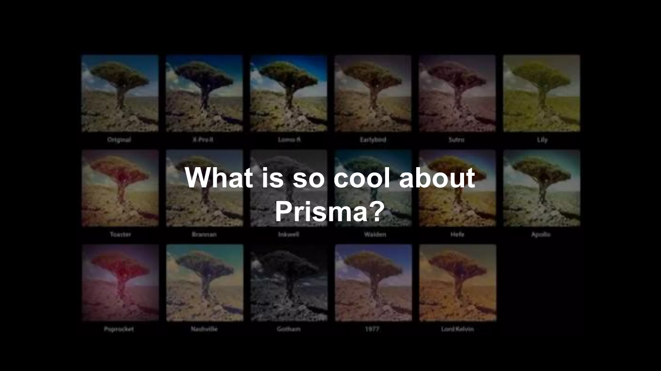

Slide 3
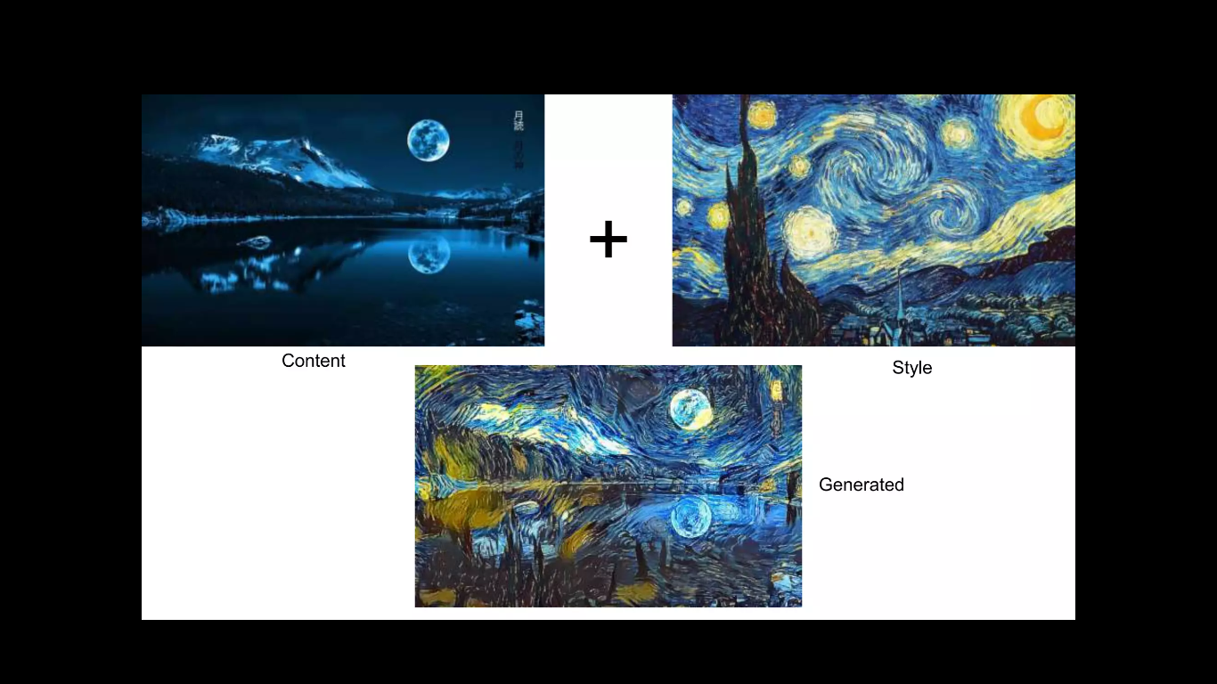

Slide 4
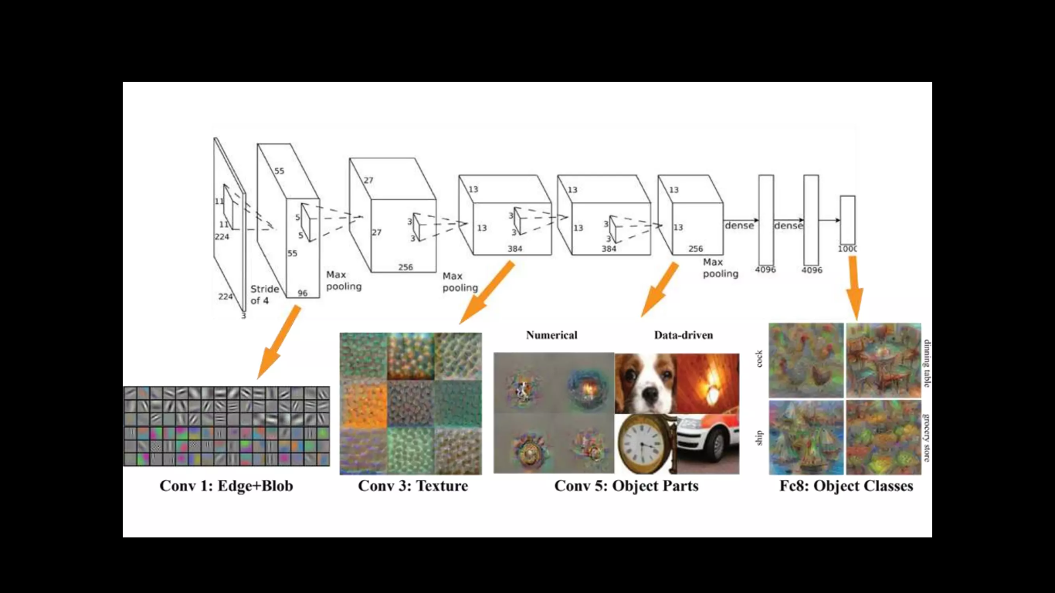

Slide 5
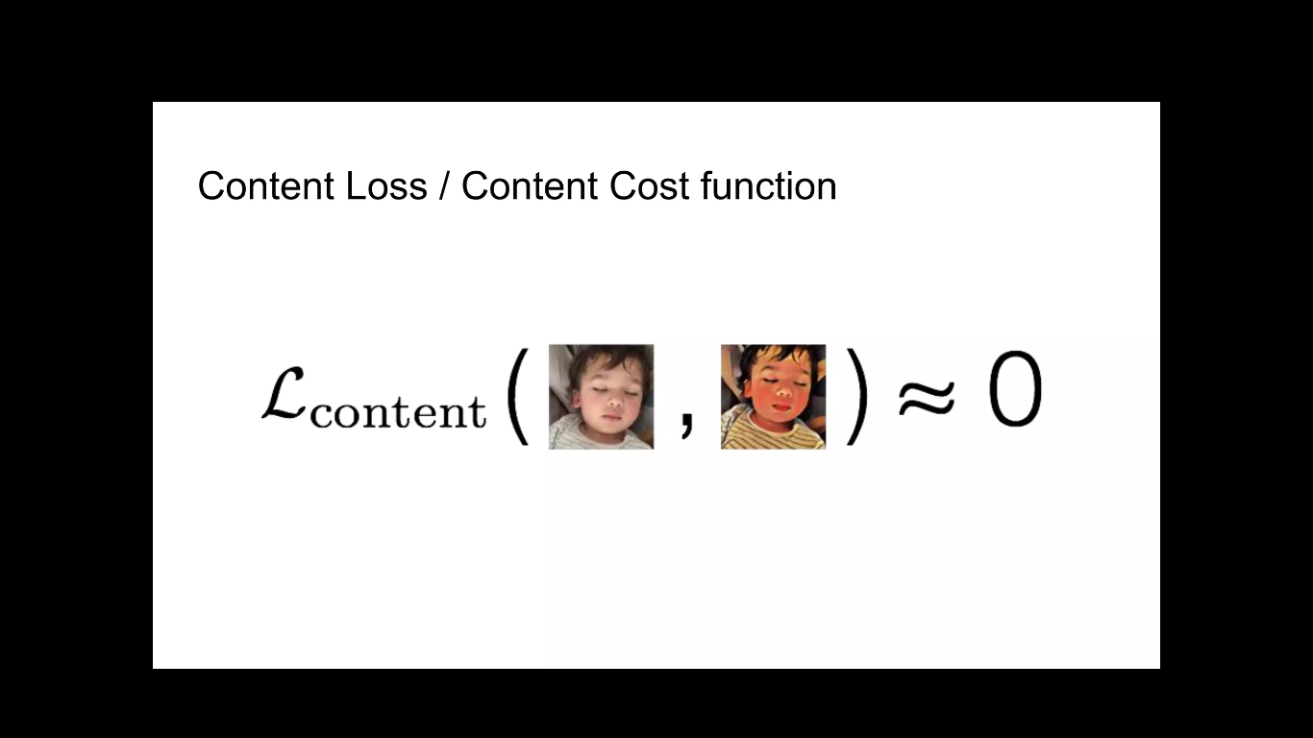

Slide 6
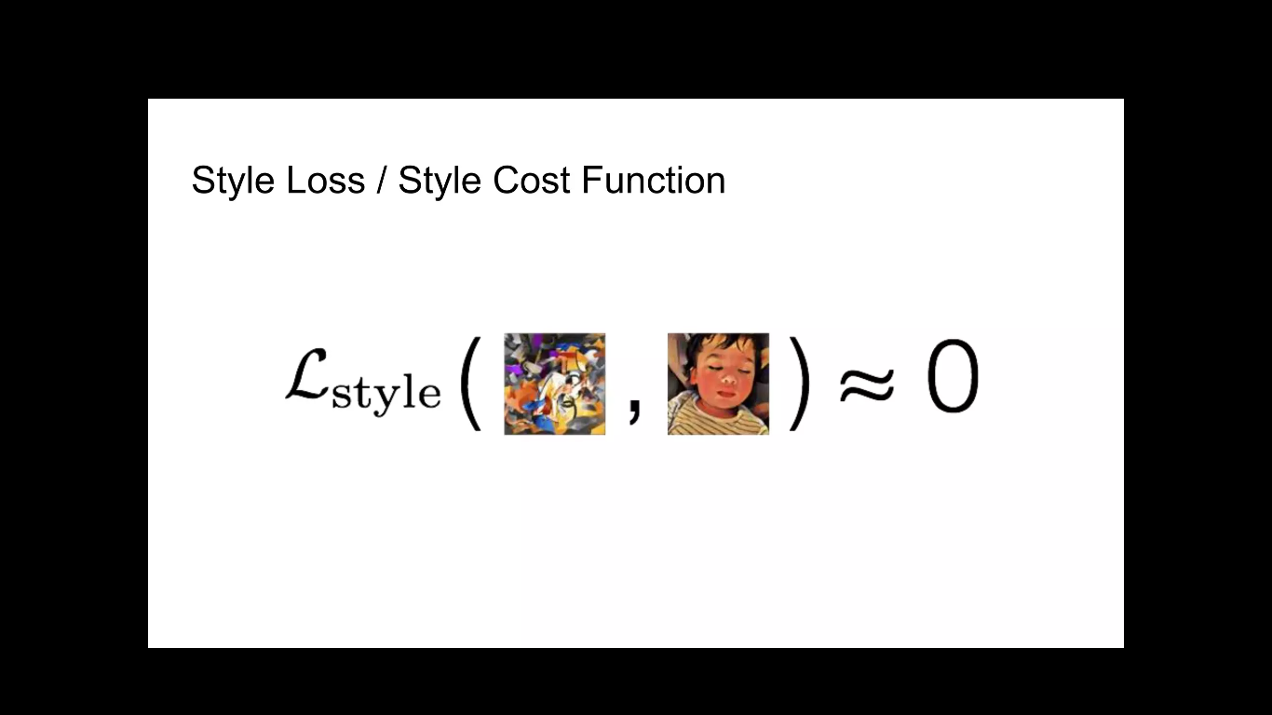

Slide 7
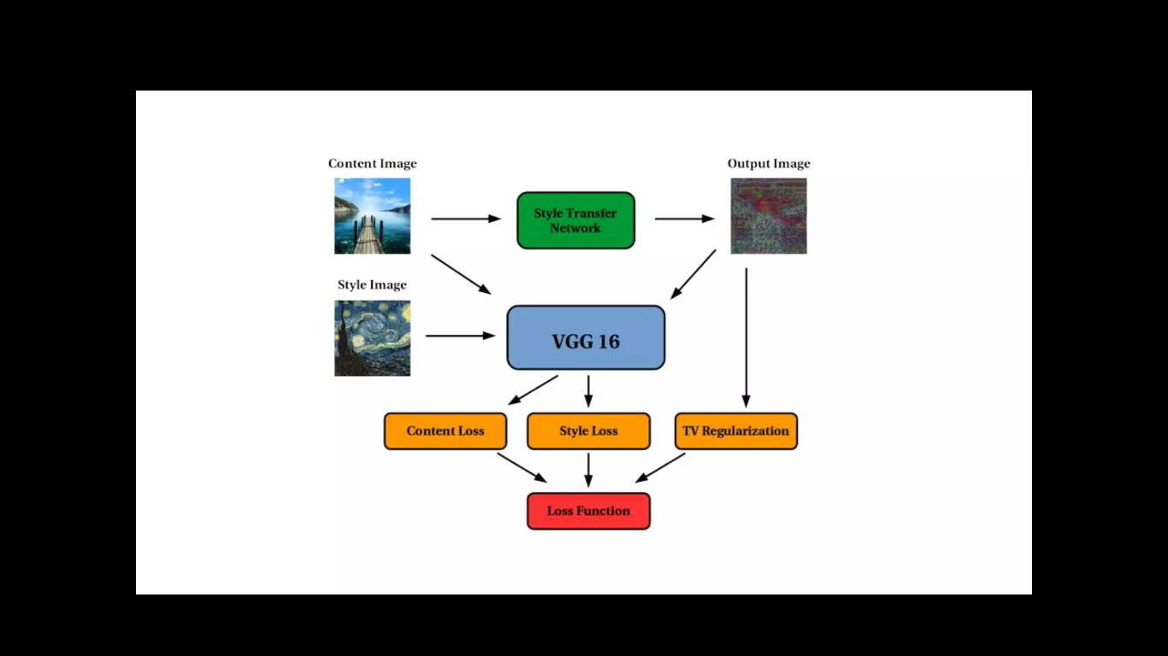

Slide 8
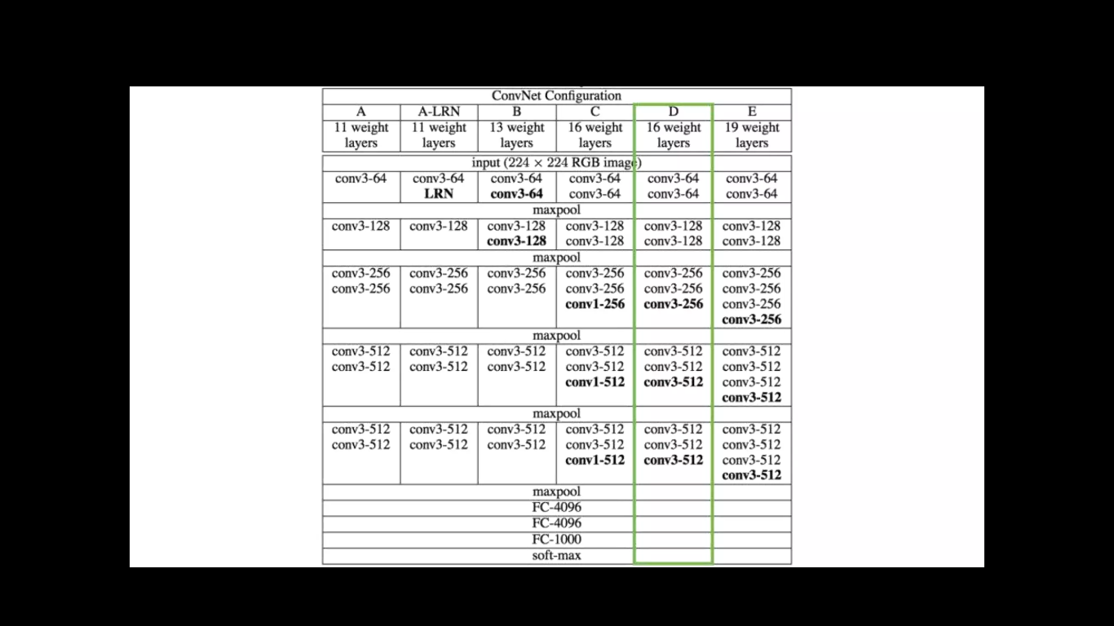

Slide 9
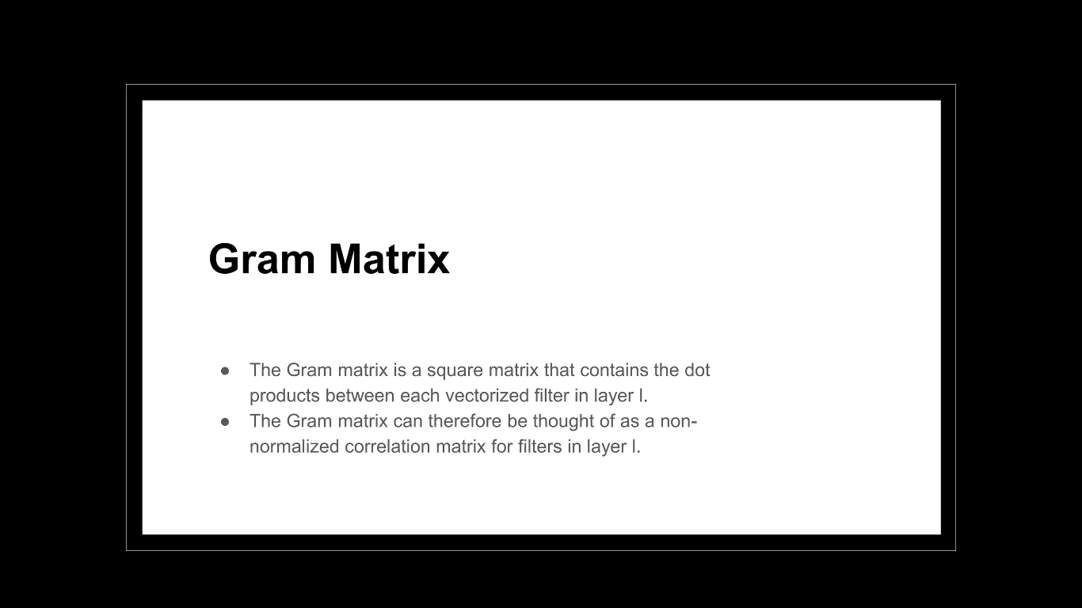

Slide 10
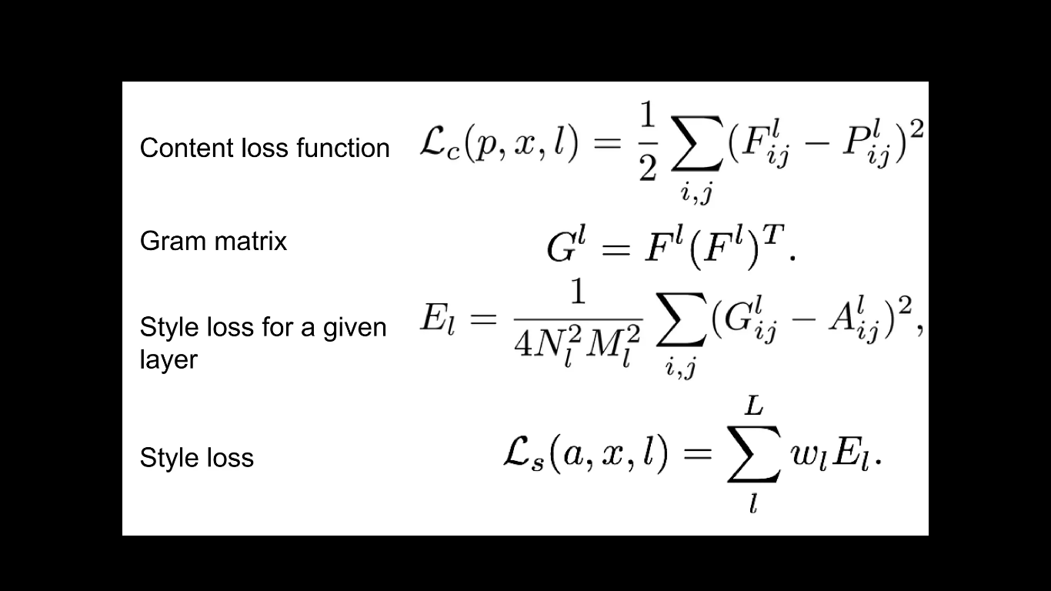

Slide 11
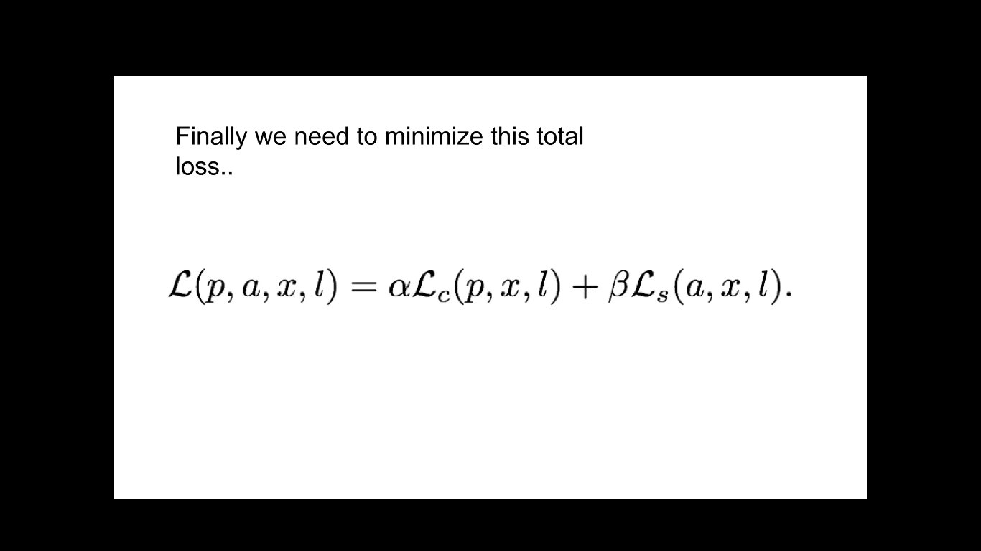

Slide 12
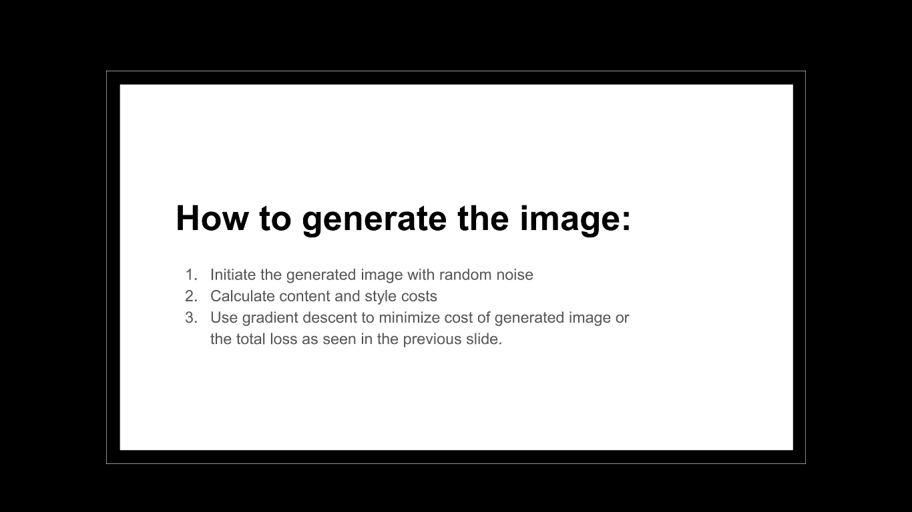

Slide 13
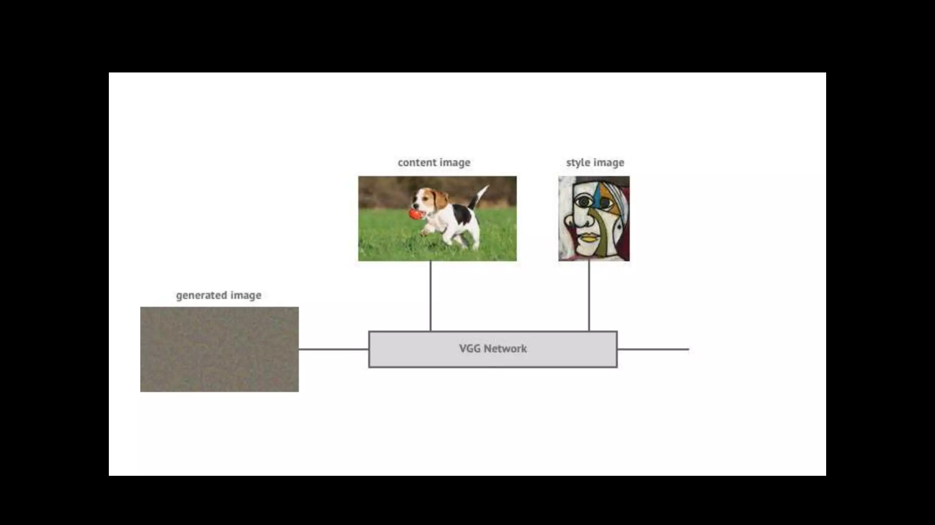

Slide 14
In neural style transfer we have two images- style and content. We need to copy the style from the style image and apply it to the content image. By, style we basically mean, the patterns, the brushstrokes, etc.
For this, we use a pretrained VGG-16 net. The original paper uses a VGG-19 net, but I couldn’t find VGG-19 weights for tensorflow, so I went with VGG-16. Actually, this (using VGG-16 instead of VGG-19) doesn’t have much impact on the final results. The resulting images are identical.

Slide 15
So intuitively, how does this work? To understand this, i’ll give you a basic intro to how convnets work. Convnets work on the basic principle of convolution. Say, for example we have an image and a filter. We slide the filter over the image and take as output, the weighted sum of the inputs covered by the filter, transformed by a nonlinearity such as sigmoid or relu or tanh. Every filter has it’s own set of weights, which do not change during the convolution operation. This is depicted beautifully in the below GIF-

Slide 16
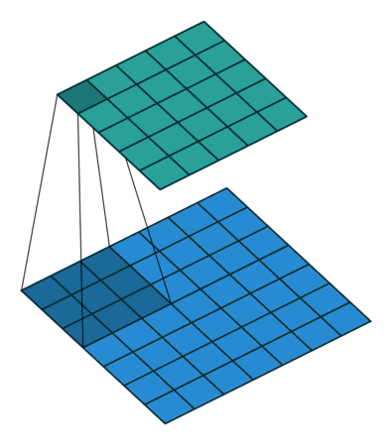
Here, the blue grid is the input. You can see the 3x3 region covered by the filter slide across the input(dark blue region). The result of this convolution is called a feature map, which is depicted by the green colored grid.

Slide 17
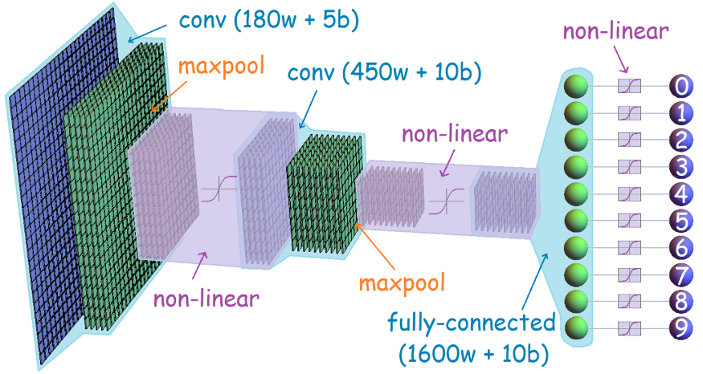
So, in a convnet, the input image is convolved with several filters and filter maps are generated. These filter maps are then convolved with some more filters and some more feature maps are generated. This is illustrated beautifully through the diagram below.

Slide 18
You can also see the term maxpool, in the above image. A maxpoollayer is mainly used for the purpose of dimensionality reduction. In a maxpool operation, we simply slide a window, say of size 2x2, across the image and take as output, the maximum of values covered by the window.
To get more information and code -https://drive.google.com/drive/folders/1YZz0zM1jX6X2OJF1pHRFW0Olr1SnyOCl?usp=share_link

